Slide 1

2020-21 3-3 Alternative stable states, phase shifts and catastrophic transitions. Chaos and unpredictability Evidence for Alternative Stable States
Vincent Jansen
vincent.jansen@rhul.ac.uk

Slide 2
Outline
3-1 Phase Shifts and Catastrophic Transitions
3-2 Alternative Stable States in Coral Reefs
3-3 Evidence for Alternative Stable States
3-4 Chaos and unpredictability

Slide 3
Alternative stable states are found in vary different ecosystems:
Lakes
Deserts
Woodlands
Fisheries
Coral reefs
See review Scheffer in Nature 2001

Slide 4
Evidence
It is hard to show in a real ecosystem that there are multiple stable states
In general, it is difficult to show this conclusively, as
Catastrophic shifts are rare events
Statistic methodology underdeveloped
to demonstrate alternative stable states you need to
Have repeated shifts
Show it plausible there are alternative stable states (fit data using models)

Slide 5
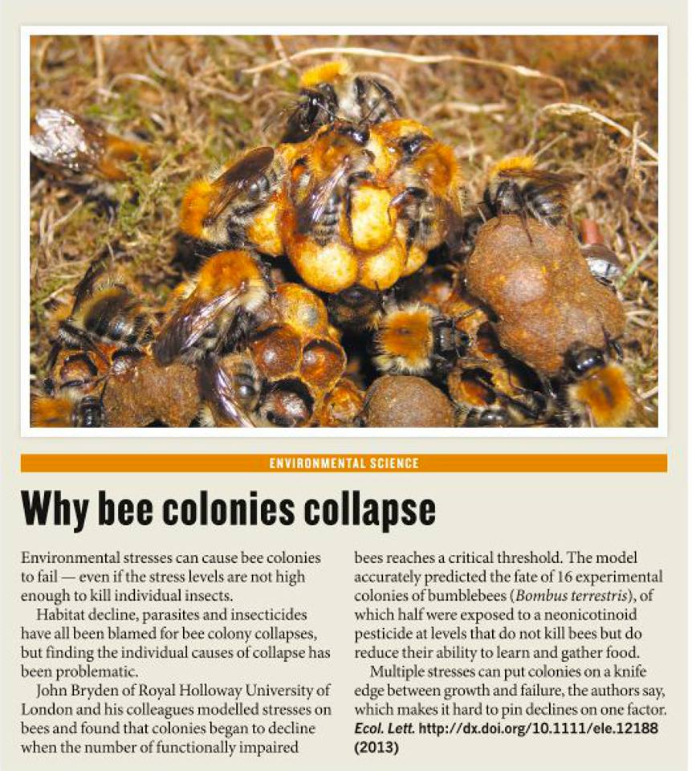
Notes:
'A healthy Bombus pascuorum colony with workers tending brood. Globally bee populations are in decline, yet there does not appear to be one primary cause. On page xxx of this issue Bryden et al. show how bumblebee colonies can fail if exposed to low levels of a neonicotinoid pesticide. Rather than killing bees outright, this exposure causes individual bees stress and affects their foraging, this in turn impairs colony function and ultimately causes colonies to fail. Since many factors can cause stress, this explains why it has been so difficult to identify a single primary cause for bee declines.'

Slide 6
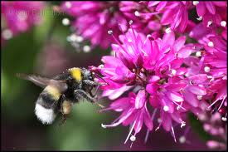
Bee decline
Insects pollinate about 75% of crop species and enable reproduction in up to 94% of wild flowering plants
One in 3 mouthfuls of food
depends on bee pollination

Slide 7
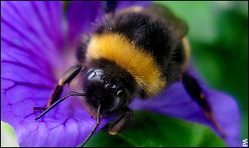
Bee decline
Pollinators are declining in many regions:
USA: 59% loss of colonies 1947-2005
Central Europe: 25% loss 1985-2005
UK: 10 of the 16 bumblebee species are declining, 6 are stable/increasing

Slide 8
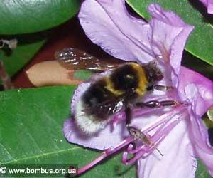
Bee decline
The reasons for bee decline are unclear and hotly debated.
Parasites, diseases, land use, invasive species, climate change and pesticide use have all been suggested as causes
None has been identified as a sole cause.

Slide 9
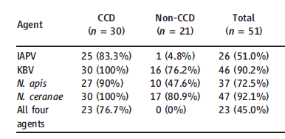
Why the cause of bee decline is so difficult to find
Prevalence of 4 diseases in collapsing colonies
Cox-Foster et al. Science (2007): 318, 283-287
Notes:
Israeli Acute paralysis virus
Kashmir Bee virus
Nosema

Slide 10
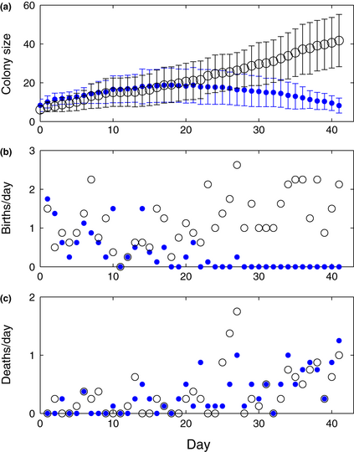
Effects of exposure of sublethal pesticides
Colonies were exposed to sublethal pesticide doses (blue). Control (grey) colonies do not fail
Bryden et al. Ecology Letters (2013)

Slide 11
Effects of exposure of sublethal pesticides
A number of models were made. One of the models has a death rate that has positive density dependence
The positive density dependence reflects that larger colonies survive better because these colonies function better (e.g forage better, are better at temperature control, hygiene, etc.)
This creates alternative stable states
Bryden et al. Ecology Letters (2013)

Slide 12
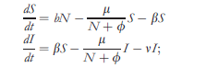
Effects of exposure of sublethal pesticides
birth
S: healthy bees
I: bees impaired by pesticide
N:S+cI: effective colony size
Note: per capita death rate density dependent.
death
impairment
death through pesticide
Bryden et al. Ecology Letters (2013)

Slide 13
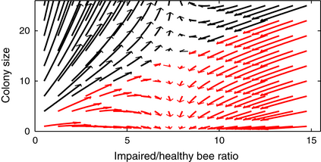
Colony dynamics
Bryden et al. Ecology Letters (2013)
Notes:
Phase plane demonstrating multiple outcomes in the dynamics of the SLS Model between colony growth and failure. Trajectories denote 20 days of the model starting from different initial conditions (see Methods for more information) and are depicted by arrows coloured according to whether they lead to continued growth (black arrows) or colony failure (red arrows). Parameters were the same as those in Fig. with β = 0.12.
© This slide is made available for non-commercial use only. Please note that permission may be required for re-use of images in which the copyright is owned by a third party.

Slide 14
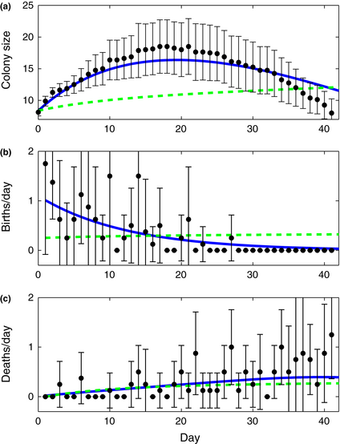
Effects of exposure of sublethal pesticides
This model (blue line) fits the data best, and better than a model with a linear death rate
Note: as the colony declines the total death rate increases
Bryden et al. Ecology Letters (2013)

Slide 15
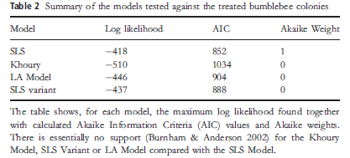
Effects of exposure of sublethal pesticides
A number of models was made. The one with the best fit is assumed to be the one that is most correct
Bryden et al. Ecology Letters (2013)

Slide 16
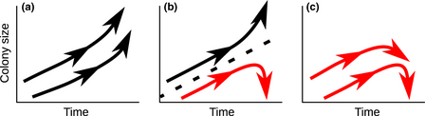
Colony dynamics
More pesticide
The model predicts that for intermediate pesticide exposure, colonies can grow, or fail. We think this can explain the result of Cox-Foster (2007) http://onlinelibrary.wiley.com/doi/10.1111/ele.12188/full#ele12188-fig-0001
Notes:
A schematic diagram showing the changing types of dynamics in the SLS Model due to an increasing rate of healthy bees becoming impaired (β increases over the three panels from left to right). Colonies with black trajectories grow whereas red trajectories lead to failure. (a) All colonies grow. (b) There is a breaking point (dashed line) between two basins of attraction depending on the numbers of bees present in the colony and the level of impaired bees in the colony; depending on initial conditions colonies will either grow or fail. (c) All colonies can grow at first but will eventually fail.
© This slide is made available for non-commercial use only. Please note that permission may be required for re-use of images in which the copyright is owned by a third party.

Slide 17
Any stress (including disease) could cause alternative fates
Prevalence of 4 diseases in collapsing colonies
Cox-Foster et al. Science (2007): 318, 283-287

Slide 18
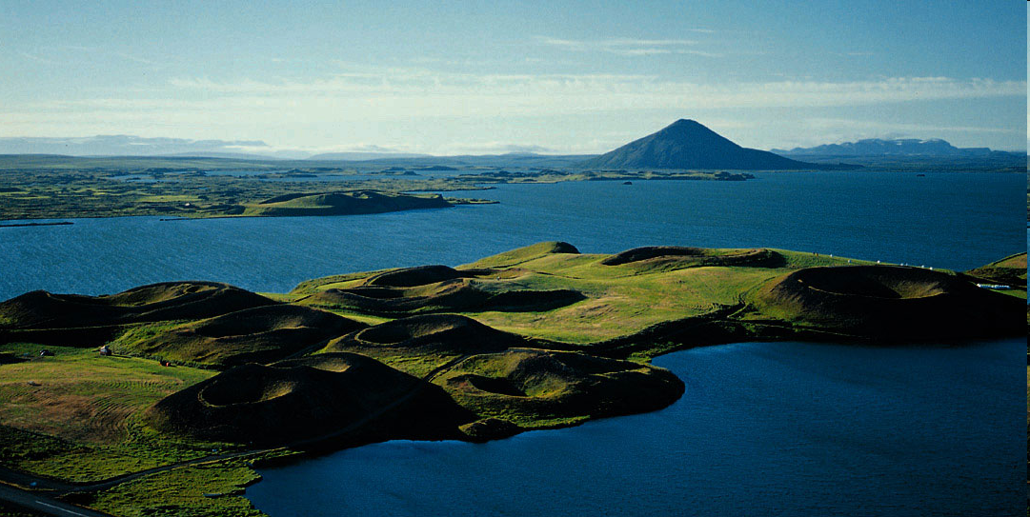
Lake Myvatn, Iceland

Slide 19
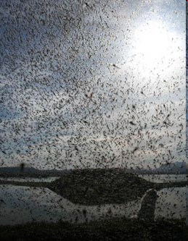
Midges can be highly abundant
Swarms ofTanytarsus gracilentus

Slide 20
From Ives et al. Nature 2008

Slide 21
Possible explanation: Alternative stable states

Slide 22
Demonstrating existence of alternative stable states
3 models are compared
Only the midge-algae detritus model has alternative stable states
This is best description given the data

Slide 23
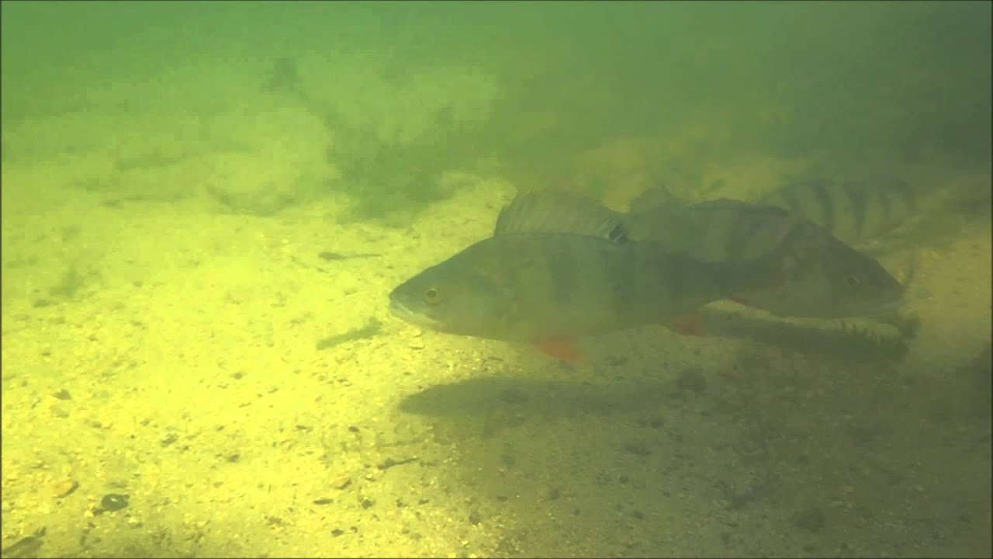
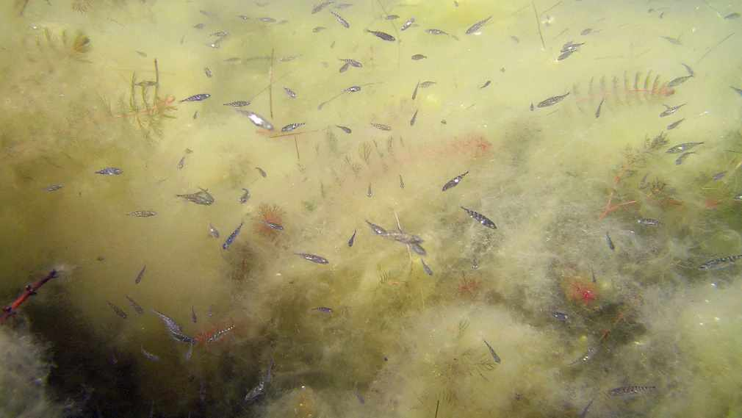
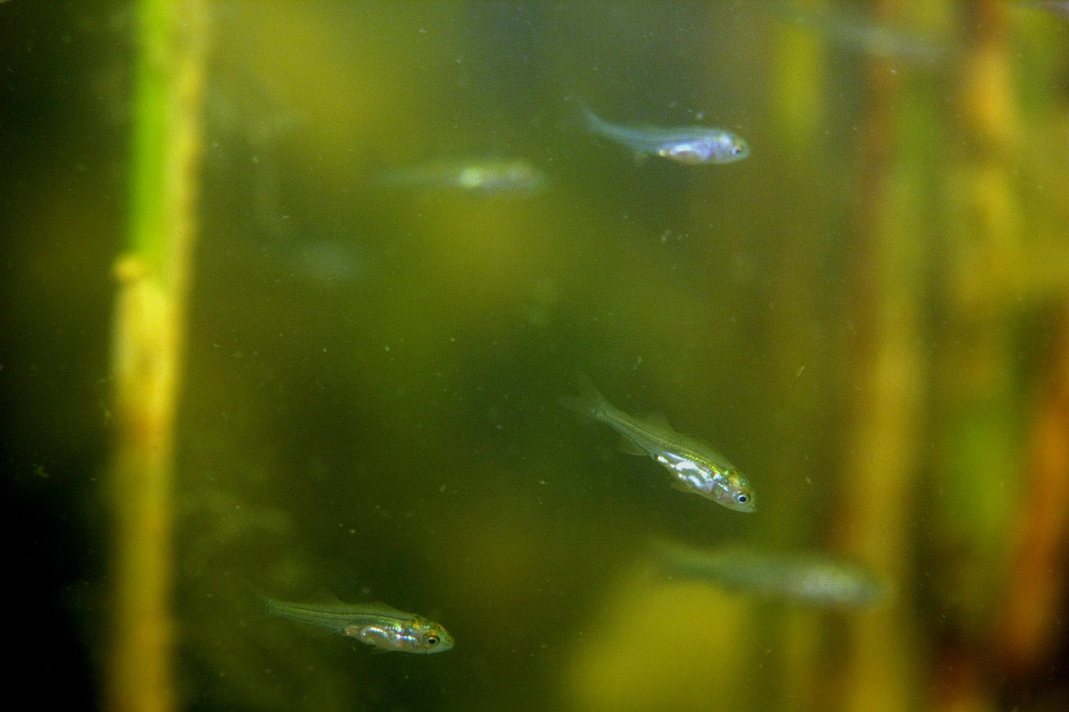
A spatial regime shift in a large coastal ecosystem
Perch (adult)
Three-spined stickleback
Perch (juvenile)

Slide 24
A spatial regime shift in a large coastal ecosystem
Swedish marine bays can be dominated by large predatory fish (perch, pike) or the three-spined stickleback.
>13,000 surveys in 486 shallow bays during 1979–2017 show a shift in dominance that gradually spread.
Eklöf, et al. A spatial regime shift from predator to prey dominance in a large coastal ecosystem. Commun Biol 3, 459 (2020). https://doi.org/10.1038/s42003-020-01180-0

Slide 25
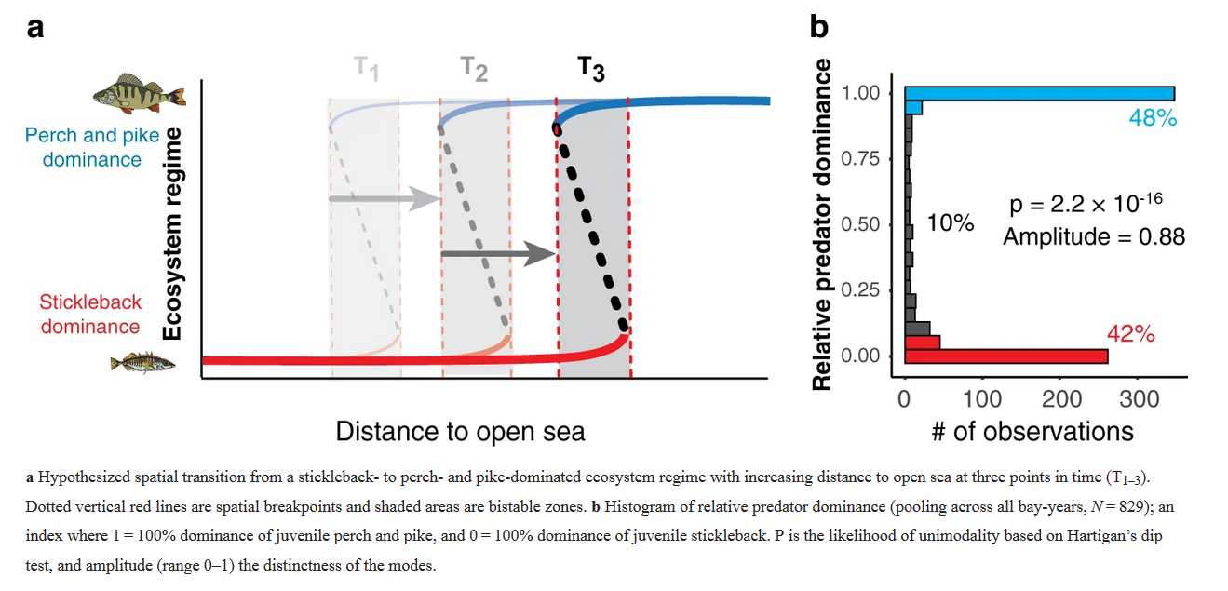
A spatial regime shift in a large coastal ecosystem

Slide 26
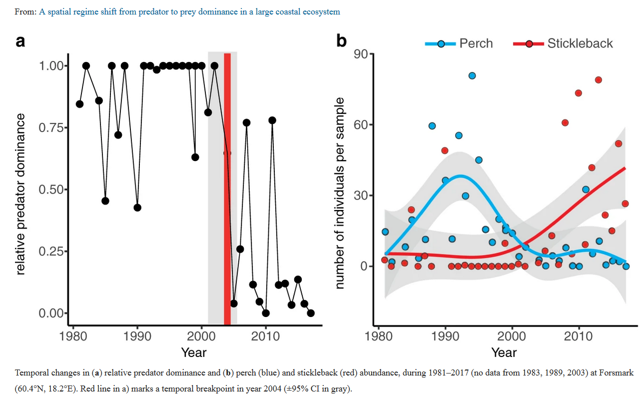
A spatial regime shift in a large coastal ecosystem

Slide 27
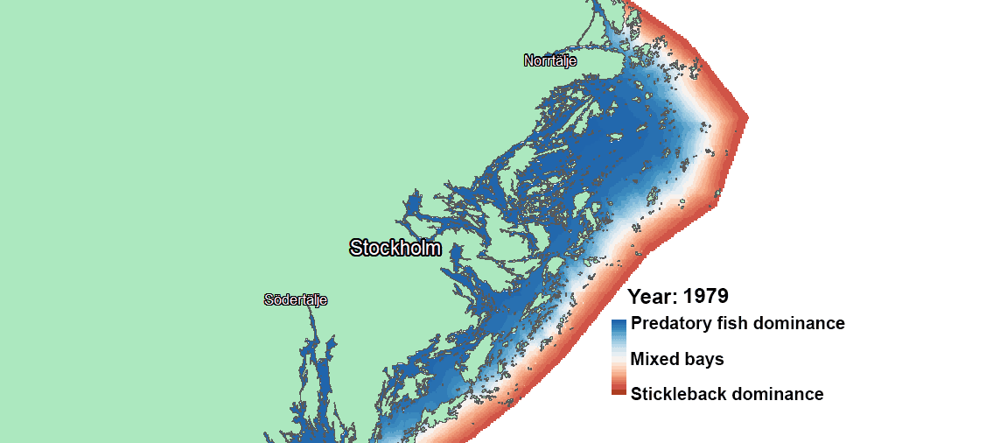
A spatial regime shift in a large coastal ecosystem
The stickleback wave' sweeping across the greater Stockholm archipelago (SW Baltic Sea) during 39 years (1979-2017).
Notes:
https://natureecoevocommunity.nature.com/posts/the-stickleback-wave-a-spatial-regime-shift

Slide 28
Learning outcomes
Appreciate the issues regarding providing evidence for alternative stable states.

